Slide 1
PRIDE Study Document Retrieval Problem
Nathan Edwards
Department of Biochemistry and
Molecular & Cellular Biology
Georgetown University Medical Center

Slide 2
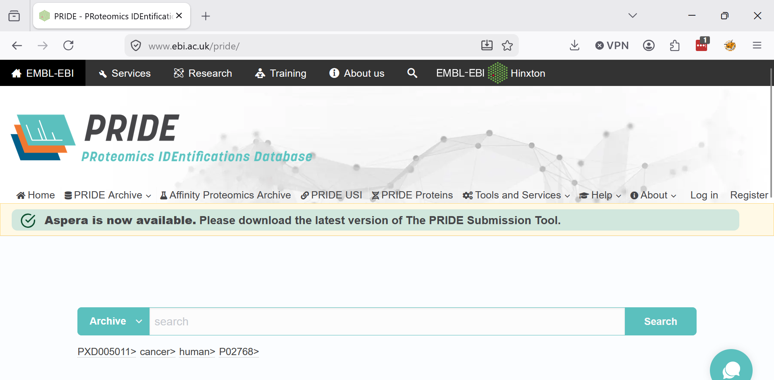
PRIDE Proteomics Resource

Slide 3
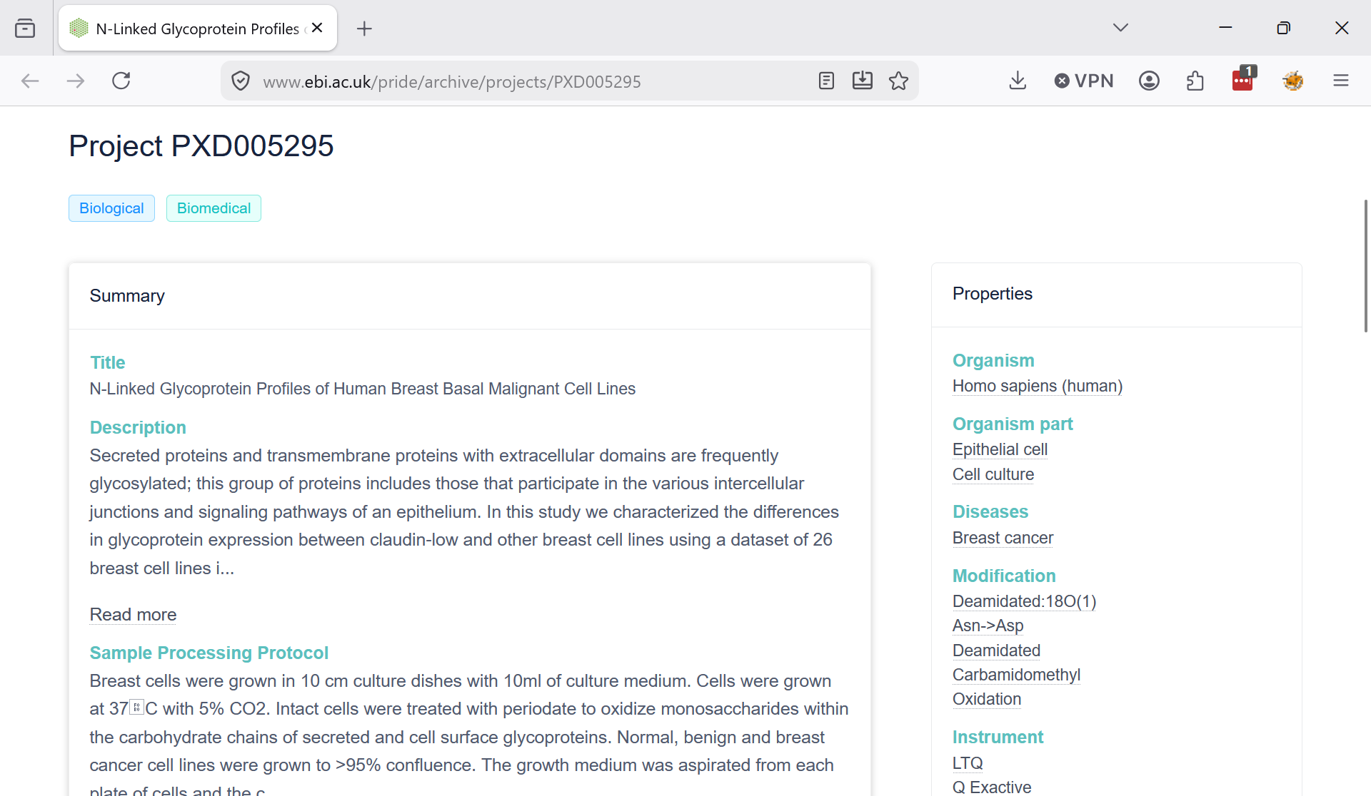
PRIDE Proteomics Resource

Slide 4
PRIDE Proteomics Resource
PRIDE provides considerable metadata about its studies and an API for search
Some metadata is explicitly modeled, but the rest is free-text descriptions:
  Title, Description, Sample Processing Protocol, Data Processing Protocol, Keywords
We want to find specific types of PRIDE studies for tagging and reprocessing.
  Specific sample preparation and analysis details

Slide 5
N-glycan site analysis
Use PNGase F to cleave N-glycans from their glycoproteins…
  Modifies (deamidates) the Asn residue [+0.98]
Standard proteomics search tools are applied
Asn residues with appropriate modification in the correct sequence motif NX[S/T] represent an N-glycosylation site.
Sometimes PNGase F is just a “cleanup”.
Can we find these studies for reanalysis?

Slide 6
The problem…
36,696 PRIDE Studies (JSON docs)
  ~ 100-200 with PNGase F
“Natural” language descriptions of sample preparation and data processing
~ 80 true positives (manually curated)
Intact glycopeptide analyses (no PNGase F) represent false positives
Can we build a model to find these studies?

Slide 7
Lets see what works!
Keyword document retrieval techniques
  BM25, TF-IDF
Text-embeddings
  OpenAI 3 small + large
Traditional ML techniques
Fine-tuned or zero-shot (Bio)BERT models
Prompt engineering, agentic loops, …

